Slide 1
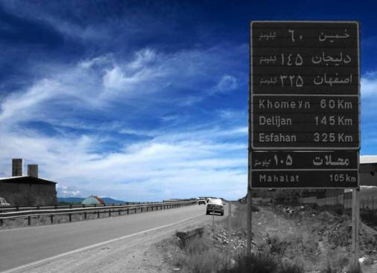
Road study and design and supervision on road construction
Road study and design and supervision on road construction
Project Title | Client | Work Quantities
Broujen – Gandoman road | Ministry of Road and Transportation | 18 Km
Ring ways and unlevel intersections of Broujen and Gandoman | Ministry of Road and Transportation | 26 Km
Arak – Khomein road | Ministry of Road and Transportation | 45 Km
Preliminary and 1st phase studies of Ghaem shahr – Joutbar road | Ministry of Road and Transportation | 25 Km
Preliminary and 1st phase studies of Tabs-Boshrouiye and Pihajat-Eshghabad roads | Ministry of Road and Transportation | 130 Km

